Slide 1
Operational Amplifier: Open Loop Configuration

Slide 2
Outline
Operational Amplifier – Terminals and VTC (Recap)
Op-Amp: Circuit Modelling
Example Problem – Op-amp model
Op-amp configuration – open and closed loop
Open Loop op-amp: Voltage Transfer Characteristics
Open Loop op-amp: Comparators
Comparator Application
Smoke detector
Automatic AC switch

Slide 3
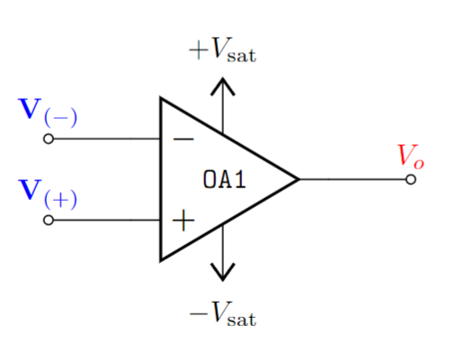
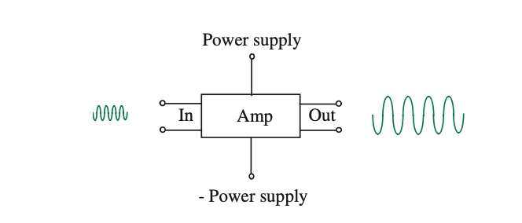
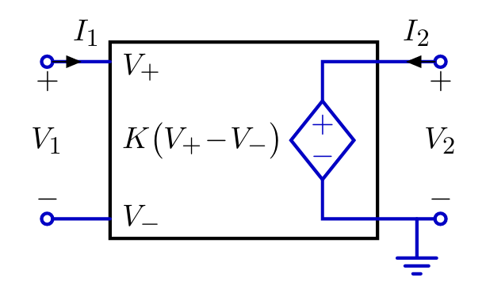


Op-Amp (Recap)
Operational:
Mathematical Operations
Amplifier:
Amplifies input signal/voltage.
Large Signal
Small Signal
An op-amp (operational amplifier) can be represented by a voltage- controlled voltage source.
Small Signal
Large Signal

Slide 4

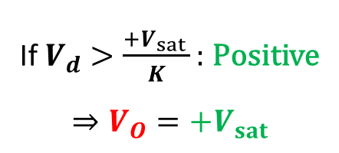


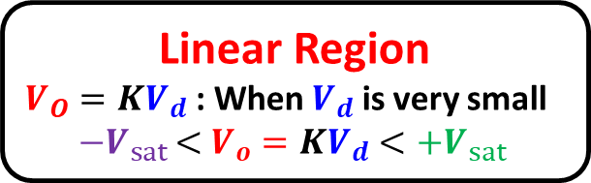




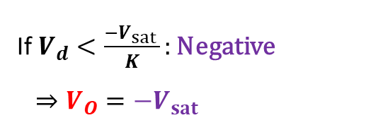

Op-Amp: VTC (Recap)
Voltage Transfer Characteristics (VTC)
Positive saturation:
Output
axis
Negative saturation:
Input
axis

Slide 5



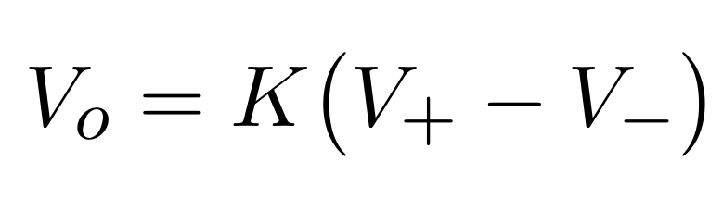


Op-Amp: Circuit Modelling
Voltage controlled voltage Source
“Ideal” op-amp approximation

Slide 6
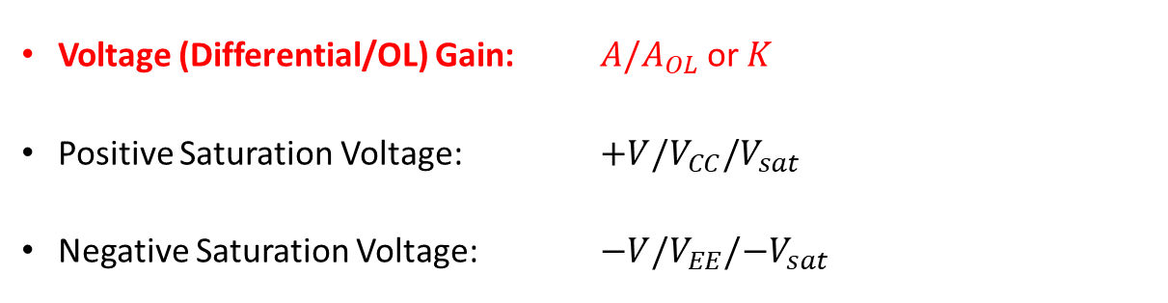





Op-amp: Circuit Model and VTC
Slope of VTC
Parameter | Typical Range | Ideally
Input
axis

Slide 7



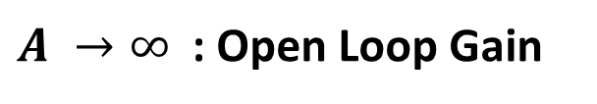
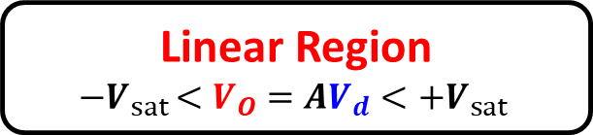

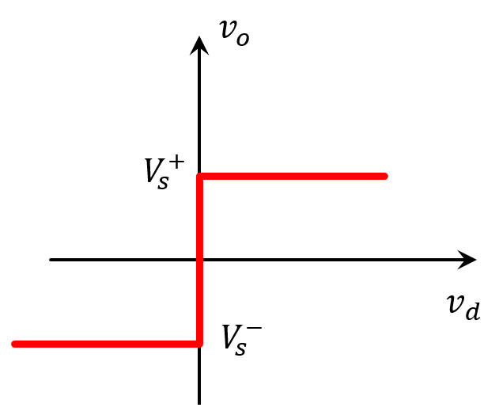








Op-amp: Circuit Model and VTC
Voltage Transfer Characteristics (VTC)
Positive saturation:
Negative saturation:

Slide 8
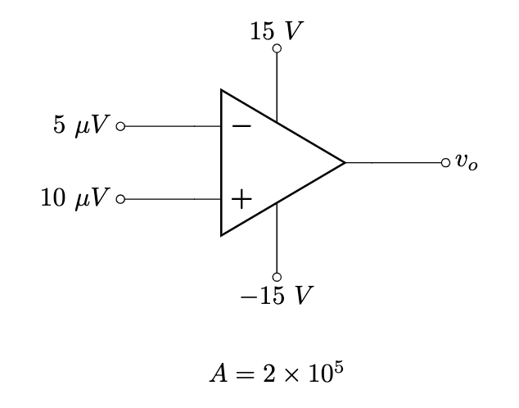
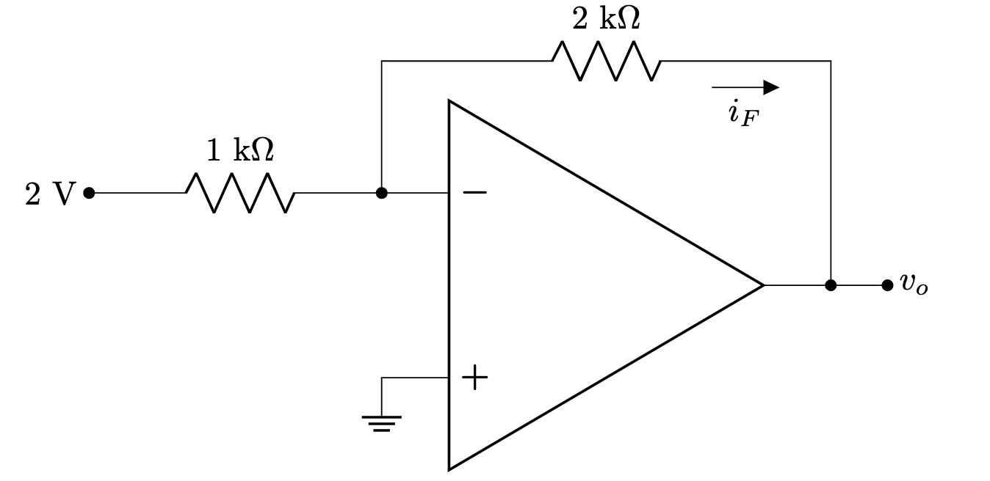
Types of Op-Amp configuration
Open loop configuration:
No physical connection between input and output
Closed loop configuration:
Feedback from output terminal

Slide 9
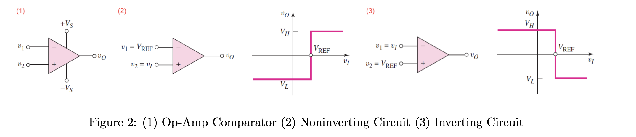


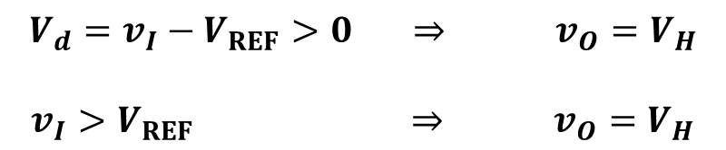
Open Loop Configuration: Comparator
Level Crossing Detector / Comparator
NON-INVERTING COMPARATOR

Slide 10


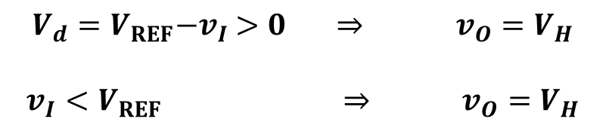
Open Loop Configuration: Comparator
Level Crossing Detector / Comparator
INVERTING COMPARATOR

Slide 11
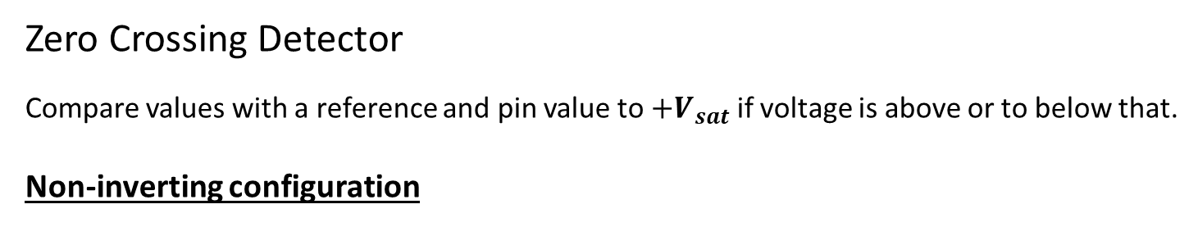
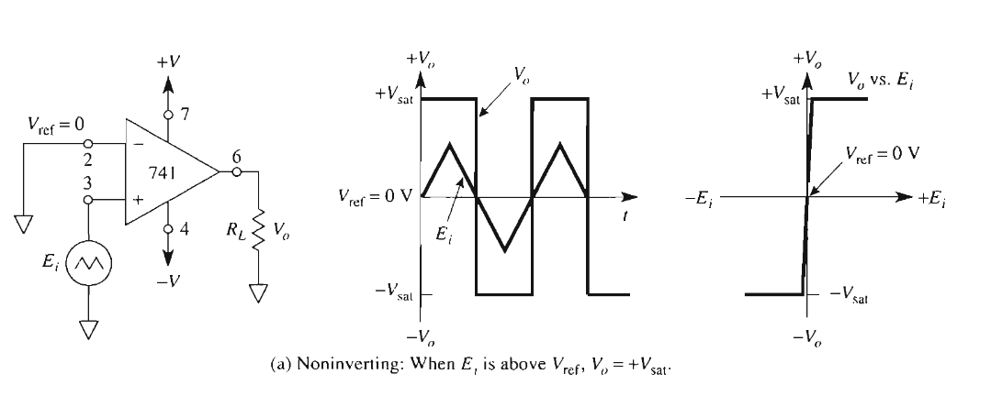
Open Loop Configuration: Comparator

Slide 12
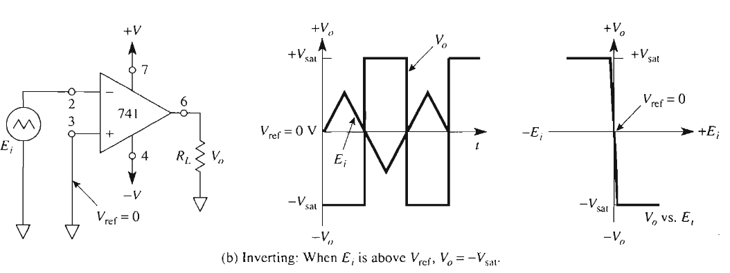
Open Loop Configuration: Comparator
Zero Crossing Detector
Inverting configuration

Slide 13
Summary
Level Crossing Detector / Comparator

Slide 14
Thank you

